Slide 1


Veteran
Services
409 Racetrack Road
Fort Walton Beach
850.833.7587
761 North 20th Street DeFuniak Springs 850. 892.1240
ext. 5167

Slide 2

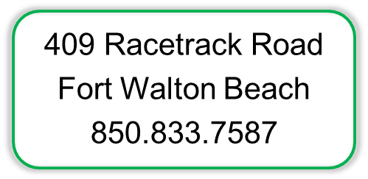
CareerSourceOkaloosaWalton.com
761 North 20th Street
DeFuniak Springs
850.892.1240
ext. 5167

Slide 3


Negotiating Your Salary
Why?
Evaluate the offer wisely
Communicate effectively
Understand the rules of the game
Salary & Wages Information

Slide 4
Why?
When somebody offers you a job, they are saying “I like you! I really, really like you.”
A negotiated $5,000 increase turns into $100,000 over a career.

Slide 5
EVALUATE
Evaluate the job description
Determine the typical pay scale
Salary is only part of the package
  Benefits – Insurance, 401K, vacation, allowances
  Schedule – Flexible, PTO, sick leave, work from home
Identify your own salary needs: your walk away number.
Consider and compare pros and cons
  Career goals
  Work environment
  Personal wants & needs

Slide 7
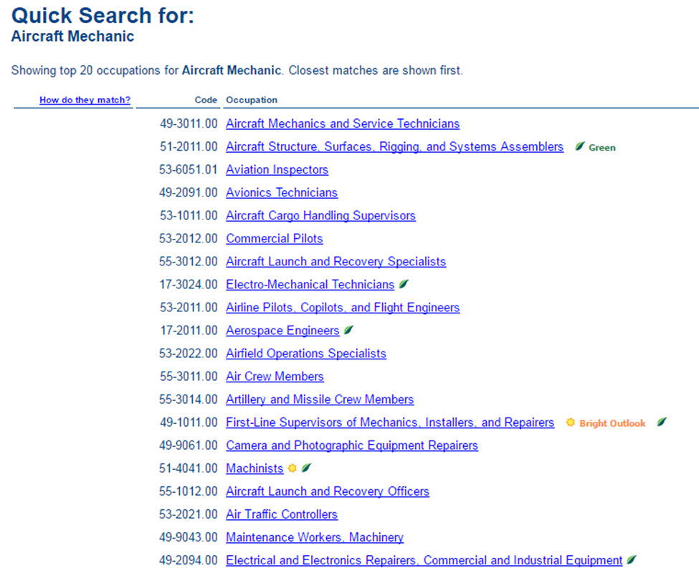

Slide 9
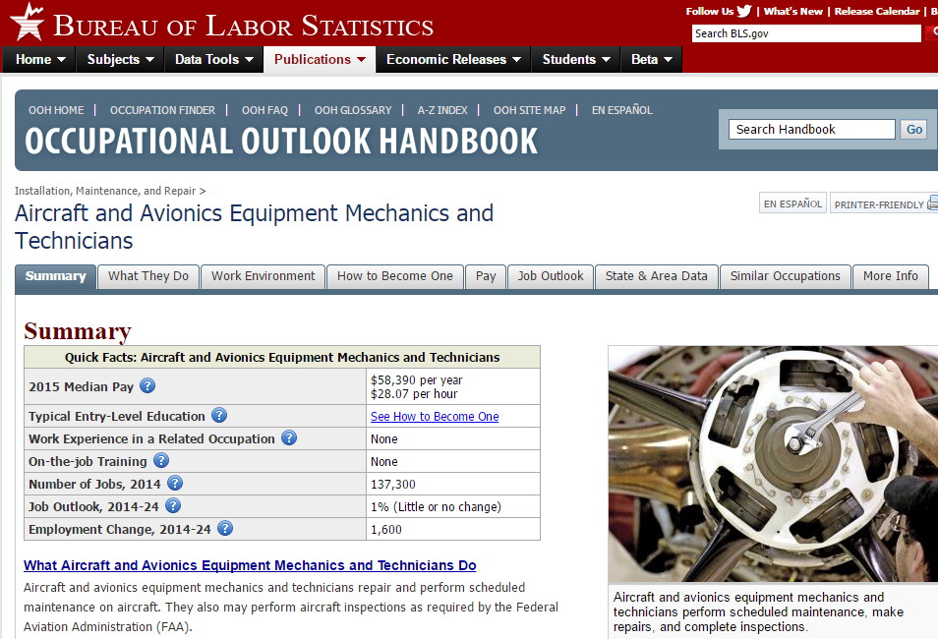

Slide 10
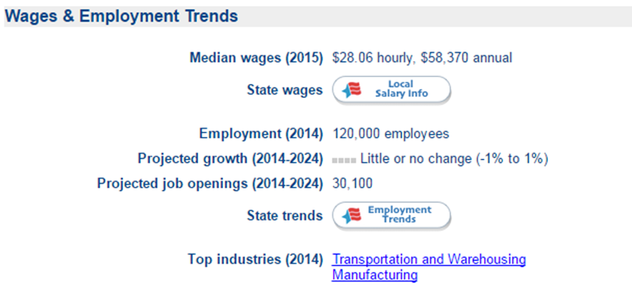

Slide 11
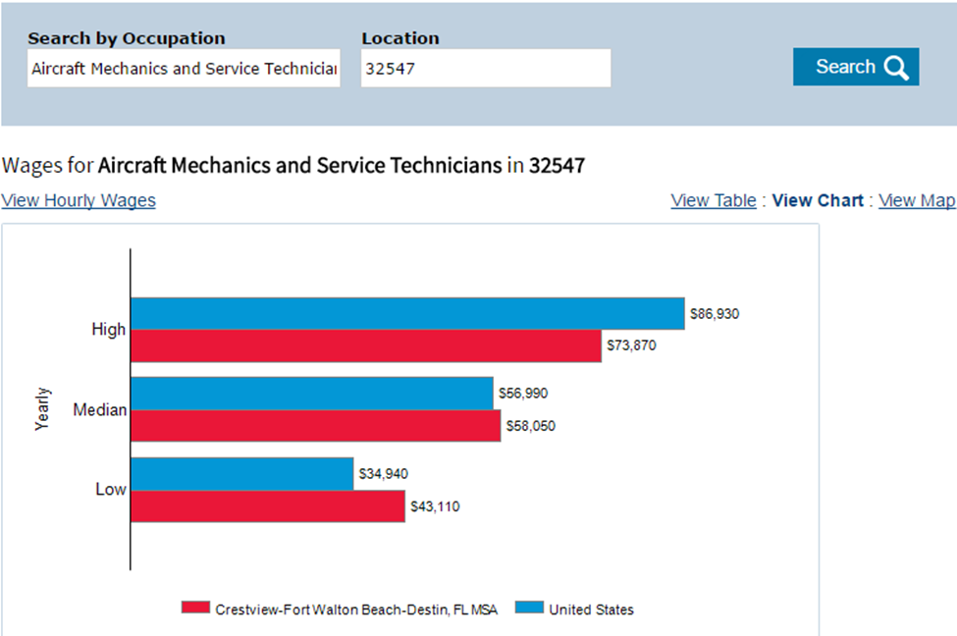

Slide 12


Slide 13
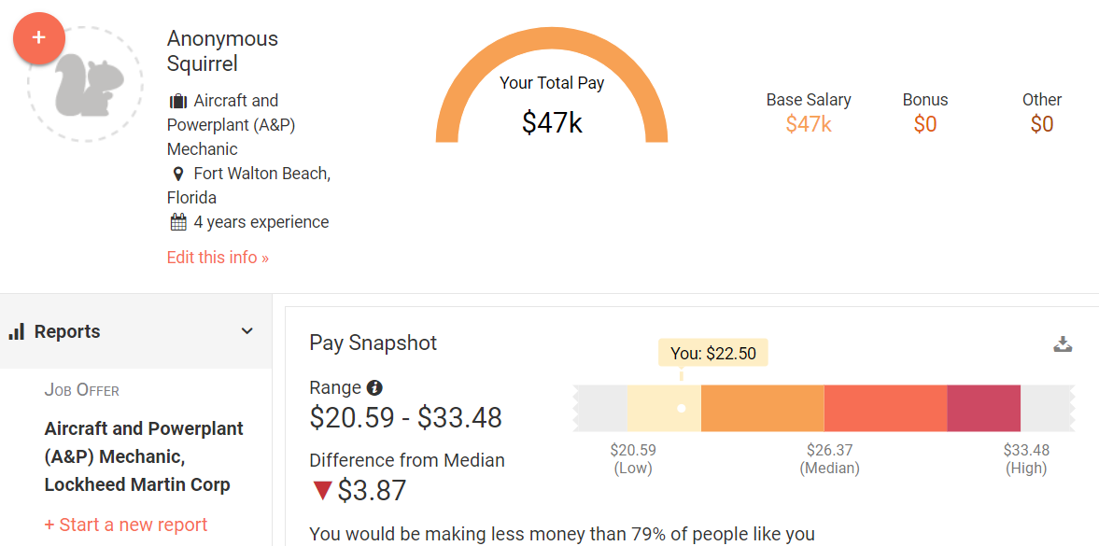
Payscale.com

Slide 14
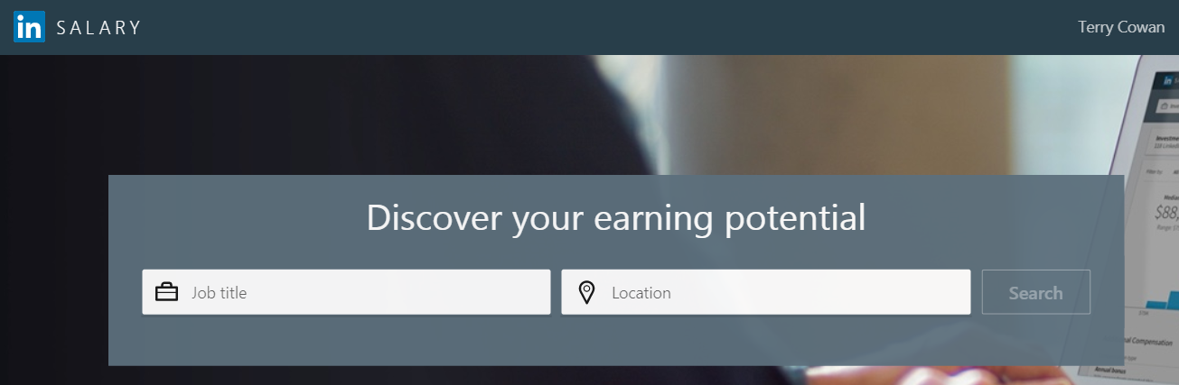
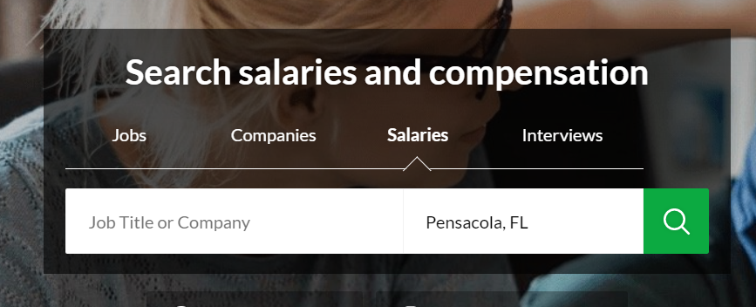
Linkedin.com/salary
Glassdoor.com

Slide 15
Communicate
Situation #1: Prying During the Prescreen
How should you respond when you’re asked about salary right off the bat? You want to demonstrate that you’re enthusiastic and cooperative, but you don’t want to tip your hand. It’s a salary negotiation tactic disguised as a gatekeeper-type interview question.
Suggested Script:
Recruiter: What’s your current salary?
You: “I’m not really comfortable sharing that information. I would prefer to focus on the value I can add to this company and not what I’m paid at my current job.”
If the interview team doesn’t know your salary, they can’t use it as their starting point. Doody writes, “that’s probably going to mean a higher initial offer for you.”
Recruiter: What’s your expected salary?
You: “I want this move to be a big step forward for me in terms of both responsibility and compensation.”

Slide 16
Communicate
Situation #2: Savvy Counter Offering
After you’ve secured an offer, Doody recommends using this formula:
“The counter offer calculator accounts for four factors—the base salary of your job offer, your minimum acceptable salary (“walk away” number), how badly the company needs you to accept the job offer, and how badly you need the job.”
Use “firm and neutral” language like this:
Suggested Script:
“Tom offered $50,000 and I would be more comfortable if we could settle on $56,000. I feel that amount reflects the importance and expectations of the position for ACME Corp’s business, and my qualifications and experience as they relate to this particular position.”

Slide 17
COMMUNICATE
Negotiate with reasonable requests
Be open to compromises
  Additional benefits?
Listen and evaluate the total package
  Consider all offers – set a time limit
If you still aren’t sure you want the job, discuss additional items
Negotiations should never become emotional or hostile
Negotiate based on value, skills, experience
  Do not negotiate based on need for the job!

Slide 18
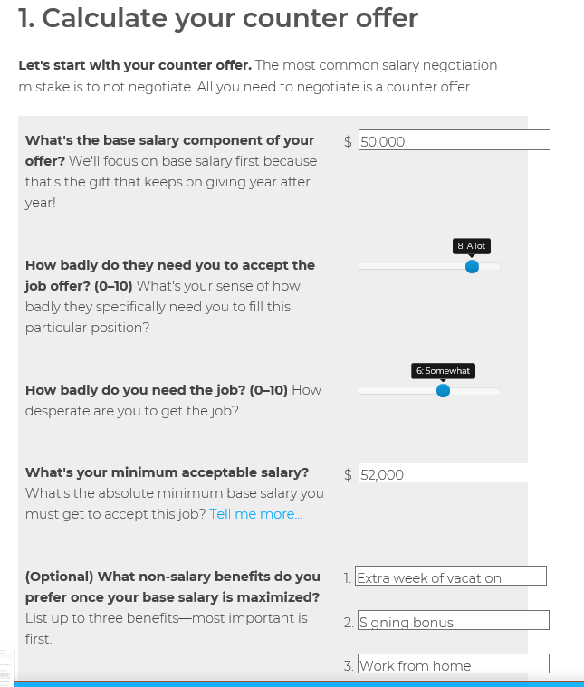
CALCULATE
Base Salary of Their Offer
Your Minimum Acceptable
How Bad They Need You
How Badly You Need the Job
Fearlesssalarynegotiation.com

Slide 19
UNDERSTAND
First offer is rarely a fixed number
If offer doesn’t change then it may be final. What then?
  Request a salary review in six months
  Turn the job down, but ask them to keep you in mind for the future
  Always leave on good terms
Request the agreement is writing and review it carefully
Even when saying “no” leave the door open for negotiation
  Do not use this as a trick to negotiate a higher wage
  Be ready to lose the job forever

Slide 20


